Slide 1


Project 1
Is there a formula to making a popular song?
Team 6
Notes:
<a href="https://www.freepik.com/free-photo/lifestyle-summer-holidays-technology-concept-carefree-happy-handsome-man-close-eyes-feeling-pleased-listening-favorite-song-wireless-headphones-feel-satisfaction-perfect-sound_17118229.htm#query=hearing%20music&position=5&from_view=search">Image by benzoix</a> on Freepik

Slide 2



Project 1
About the project
About the project
Is there a formula for making a popular song?
Data Collection
Data Cleaning
We were hired by a record company to analyze the current music industry and let them know if there is such thing as a formula for making a popular song.
Platform Comparison
Song’s Attributes
Single Artist vs Collaborations
Song’s Release Date
Conclusions
Notes:
Photo by Frank Septillion on Unsplash

Slide 3

Project 1
Data Collection
About the project
For our analysis we used a database with the most streamed Spotify songs between January 2023 and July 2023.
Data Collection
Data Cleaning
Platform Comparison
The database provides insights into each song's attributes, popularity, and presence on various music platforms.
Song’s Attributes
Single Artist vs Collaborations
Most Streamed Spotify Songs
Song’s Release Date
Song’s Attributes
The dataset was taken from Kaggle.
Conclusions
Song’s Pupularity
Presence in Music Platforms
Notes:
Photo by Frank Septillion on Unsplash
Photo by Joshua Fuller on Unsplash

Slide 4
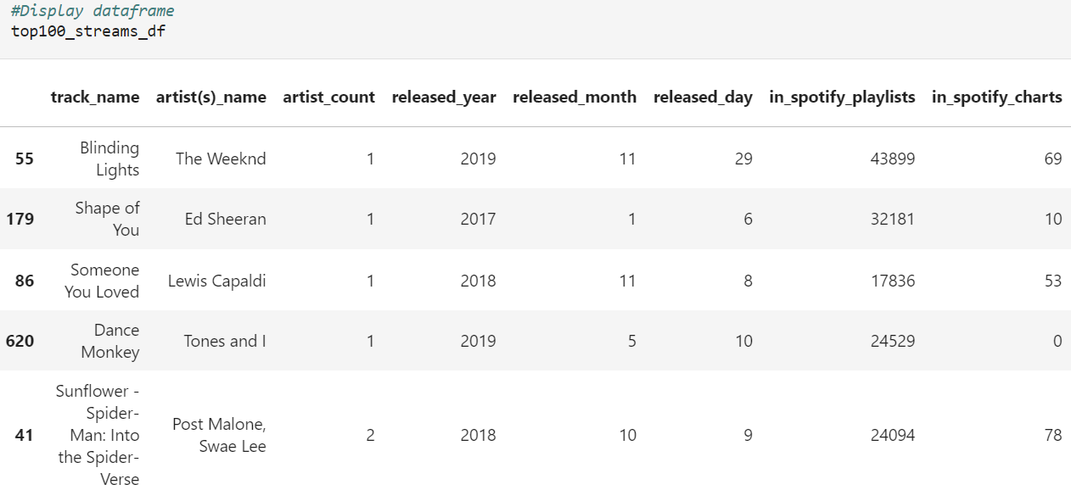
Project 1
Data Cleaning
About the project
First, we analyzed the information included in the dataset and started by creating a sample with the 100 songs that had the higher number of streams in Spotify during the analyzed period.
Using jupyter notebook, we created a DataFrame with the sample data, which will be the one that we’ll use for the following sections of the analysis.
Data Collection
Data Cleaning
Platform Comparison
Song’s Attributes
Single Artist vs Collaborations
Song’s Release Date
Conclusions
Notes:
Photo by freestocks on Unsplash
Photo by Martin Hexeberg on Unsplash
Photo by Alexander Popov on Unsplash
Photo by Matthias Wagner on Unsplash

Slide 5
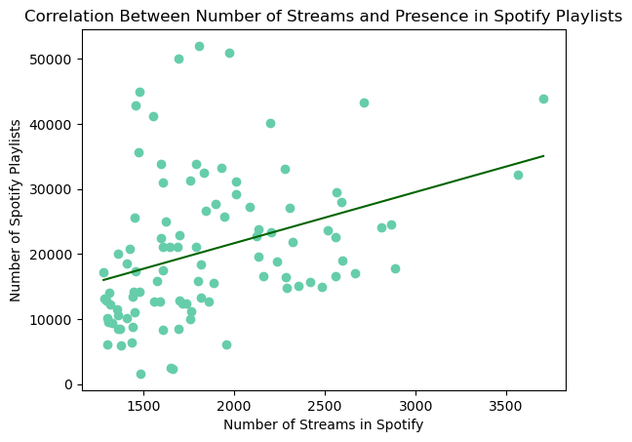
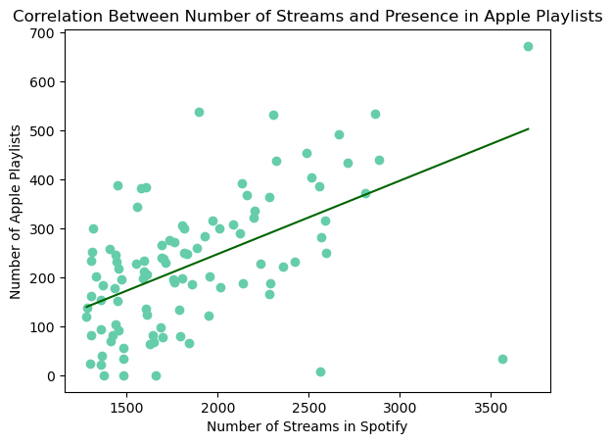
Project 1
Platform Comparison
We found positive correlations between the number of streams in Spotify and the presence of each song in Spotify and Apple Music Playlists, although the correlation was stronger for the second one.
It is important to highlight that the playlists that are being considered are the official playlists developed by each platform. Therefore, our advice the the record company would be that arranging with the platform the inclusion of the song in the official playlists could be a good marketing campaign for promoting the song.
About the project
Data Collection
Data Cleaning
Platform Comparison
Song’s Attributes
Single Artist vs Collaborations
Song’s Release Date
Conclusions
Notes:
Photo by melanie van leeuwen on Unsplash
Photo by te nguyen on Unsplash
Photo by claudia raya on Unsplash
Photo by soundtrap on Unsplash

Slide 6
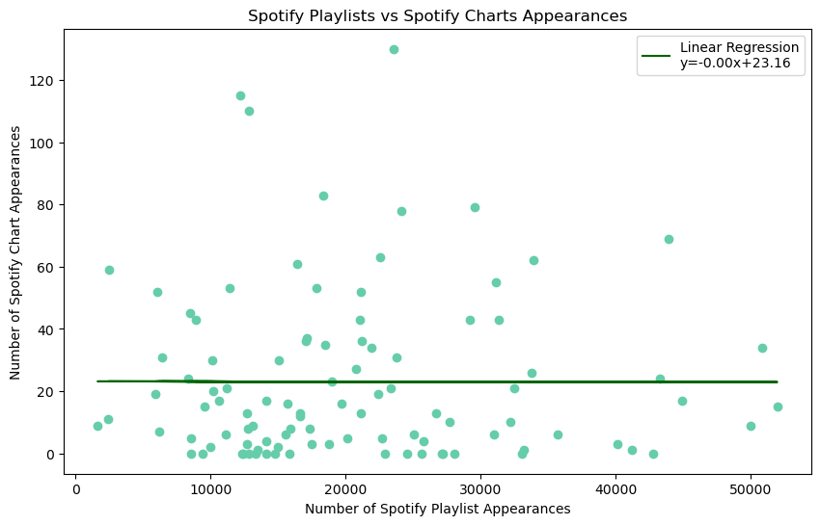
Project 1
Platform Comparison
Playlist vs Charts
Spotify indicated a very weak negative correlation between the number of playlist appearances and chart appearances, suggesting that being included in more Spotify playlists does not guarantee higher chart success on the platform.
About the project
Data Collection
Data Cleaning
Platform Comparison
Song’s Attributes
Single Artist vs Collaborations
Song’s Release Date
Conclusions
Notes:
Photo by melanie van leeuwen on Unsplash
Photo by te nguyen on Unsplash
Photo by claudia raya on Unsplash
Photo by soundtrap on Unsplash

Slide 7
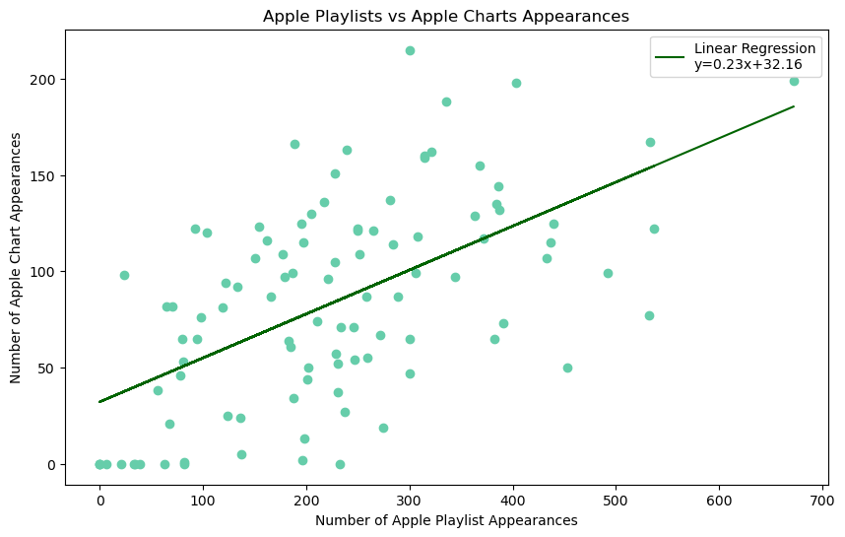
Project 1
Platform Comparison
Playlist vs Charts
Apple showed a moderate positive correlation, indicating that songs appearing in more Apple playlists tend to also have more chart appearances. This could suggest a more direct impact of playlist inclusion on chart performance within the Apple music ecosystem.
About the project
Data Collection
Data Cleaning
Platform Comparison
Song’s Attributes
Single Artist vs Collaborations
Song’s Release Date
Conclusions
Notes:
Photo by melanie van leeuwen on Unsplash
Photo by te nguyen on Unsplash
Photo by claudia raya on Unsplash
Photo by soundtrap on Unsplash

Slide 8
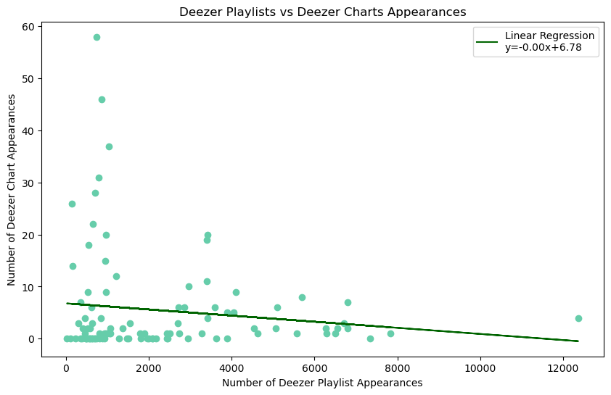
Project 1
Platform Comparison
Playlist vs Charts
Deezer displayed a very slight negative correlation, similar to Spotify, implying that more playlist appearances might not significantly influence chart success on Deezer.
About the project
Data Collection
Data Cleaning
Platform Comparison
Song’s Attributes
Single Artist vs Collaborations
Song’s Release Date
Conclusions
Notes:
Photo by melanie van leeuwen on Unsplash
Photo by te nguyen on Unsplash
Photo by claudia raya on Unsplash
Photo by soundtrap on Unsplash

Slide 9
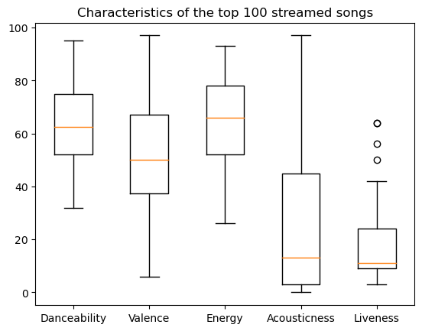
Project 1
Songs Attributes
About the project
We used the mean and the median to set the percentage of each characteristic of the song must have to be more likeable streamed.
Data Collection
The mean of Danceability is 62.99
The mean of Valence is 50.84 The mean of Energy is 64.67 The mean of Acousticness is 26.46 and the median 13.0
The mean of Liveness is 17.35 and the median 11.0
Danceability, Valence and Energy % data is well distributed.
Data Cleaning
Platform Comparison
Song’s Attributes
Single Artist vs Collaborations
Song’s Release Date
Conclusions
Notes:
Photo by melanie van leeuwen on Unsplash
Photo by te nguyen on Unsplash
Photo by claudia raya on Unsplash
Photo by soundtrap on Unsplash

Slide 10
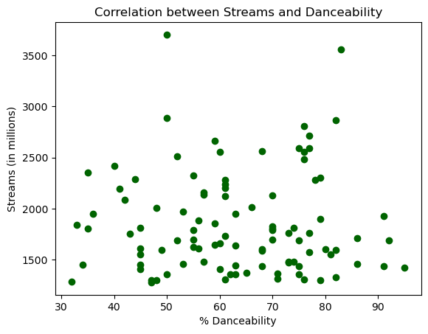
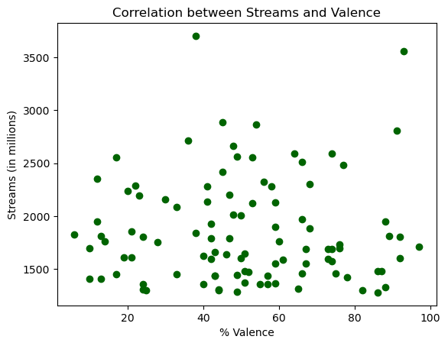
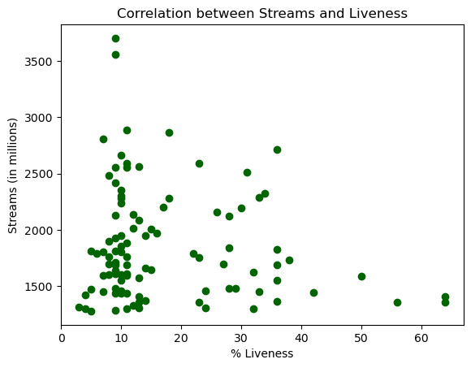
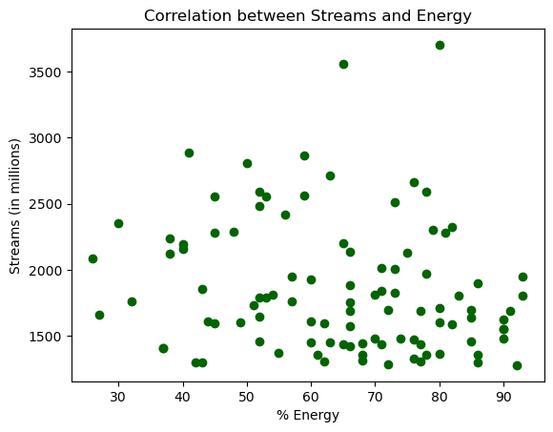
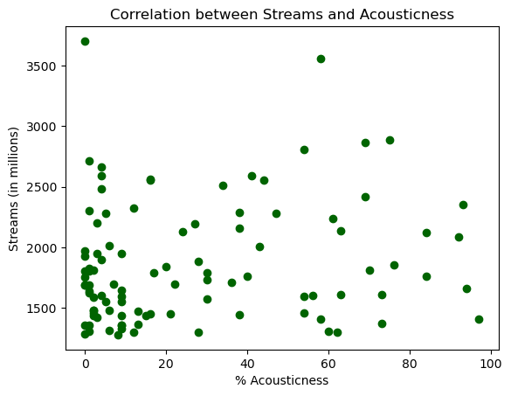
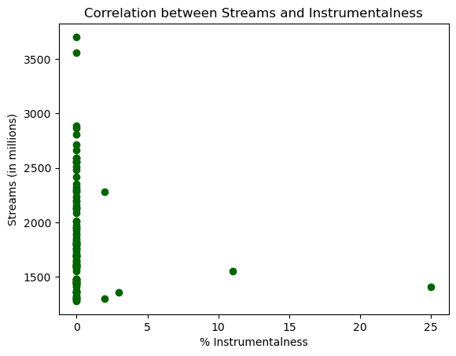
Project 1
Songs Attributes
About the project
There is no valuable correlation between the increase % of each attribute and the amount of streams.
Data Collection
Data Cleaning
Platform Comparison
Song’s Attributes
Corr .008
Corr .007
Corr -.176
Single Artist vs Collaborations
Song’s Release Date
Conclusions
Corr .166
Corr .141
Corr -.121
Notes:
Photo by melanie van leeuwen on Unsplash
Photo by te nguyen on Unsplash
Photo by claudia raya on Unsplash
Photo by soundtrap on Unsplash

Slide 11
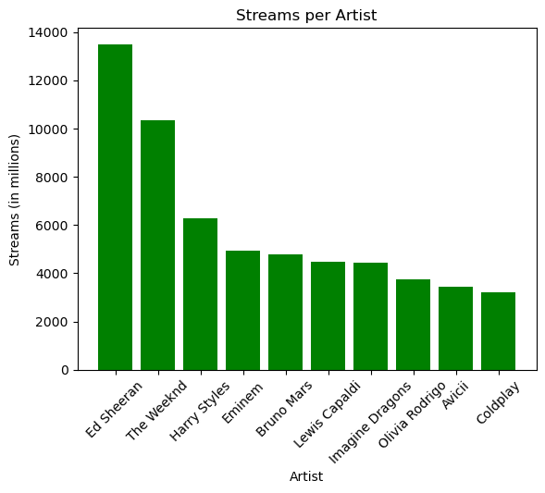
Project 1
Songs Attributes
About the project
These are the artist with most streams on th the top 100, which could indicate that a collaboration with them could make your song more streamed
Data Collection
Data Cleaning
Platform Comparison
Song’s Attributes
Single Artist vs Collaborations
Song’s Release Date
Conclusions
Notes:
Photo by melanie van leeuwen on Unsplash
Photo by te nguyen on Unsplash
Photo by claudia raya on Unsplash
Photo by soundtrap on Unsplash

Slide 12
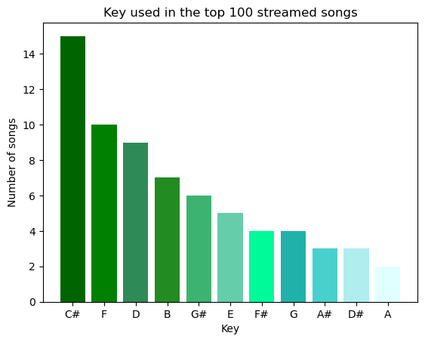
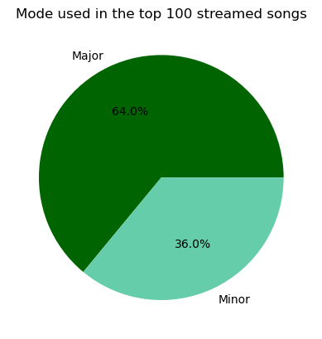
Project 1
Songs Attributes
About the project
We also analyzed the most used key in the top 100 streamed songs, which we found to be C#, followed by F and D.
Regarding the mode, the majority of the songs in the top 100 streamed list have a major mode.
Data Collection
Data Cleaning
Platform Comparison
Song’s Attributes
Single Artist vs Collaborations
Song’s Release Date
Conclusions
Notes:
Photo by melanie van leeuwen on Unsplash
Photo by te nguyen on Unsplash
Photo by claudia raya on Unsplash
Photo by soundtrap on Unsplash

Slide 13
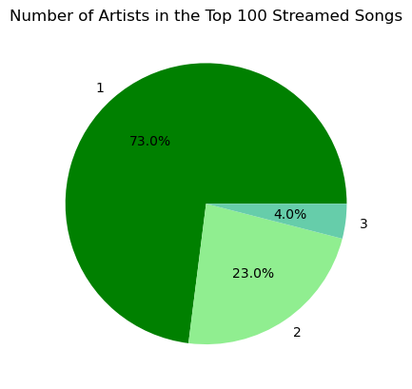
Project 1
Single Artist vs. Collaborations
About the project
Most of the songs included in the top 100 streamed songs in Spotify were recorded by a single artist. This was a result that we were not expecting given that during the last years collaborations between artists have been a popular trend. However, our analysis showed that songs by a single artist were more popular.
Data Collection
Data Cleaning
Platform Comparison
Song’s Attributes
Single Artist vs Collaborations
Song’s Release Date
Conclusions
Notes:
Photo by melanie van leeuwen on Unsplash
Photo by te nguyen on Unsplash
Photo by claudia raya on Unsplash
Photo by soundtrap on Unsplash

Slide 14

Top 100 Songs by Released Date
Project 1
About the project
Data Collection
When analysing top 100 release dates we noticed an interesting pattern. The first half of the year has more songs than the second half. This can be validated with the following data
Data Cleaning
Platform Comparison
Song’s Attributes
Single Artist vs Collaborations
Song’s Release Date
Conclusions

Slide 15
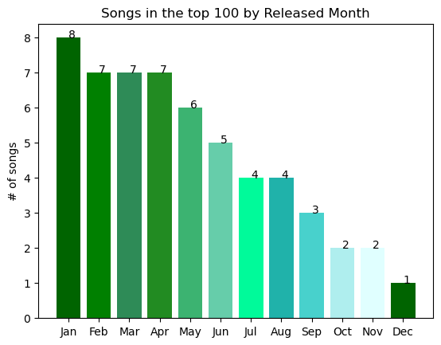
Top 100 Songs by Released Date
Project 1
About the project
Data Collection
Here we see that January is the month with the most songs in the top, as the year progresses we see a decrement in this number
Data Cleaning
Platform Comparison
Song’s Attributes
Single Artist vs Collaborations
Song’s Release Date
Conclusions

Slide 16
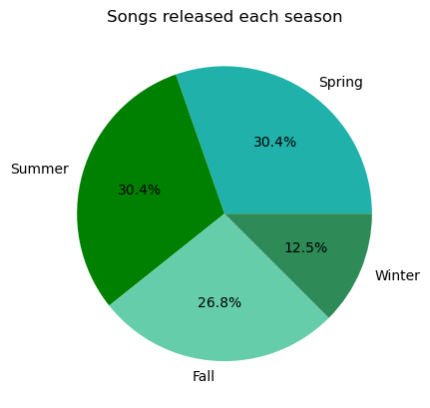
Top 100 Songs by Released Date
Project 1
About the project
To complete the data we analysed by season and noticed that the pattern is still the same. The later on the year the less songs in the top
Data Collection
Data Cleaning
Platform Comparison
Song’s Attributes
Single Artist vs Collaborations
Song’s Release Date
Conclusions

Slide 17
Conclusions & Next Steps
Project 1
Our thorough data analysis reveals intricate patterns and correlations within the music industry, particularly on streaming platforms. A standout finding is the moderate positive correlation between platform playlists appearances suggesting that strategic placement in these playlists could bolster a song's visibility and popularity.
Spotify and Deezer showed weak to negligible correlations, A playlist appearances isn’t a consistent predictor of chart success on these platforms. Apple in the other side shows a positive correlation between playlists and charts. Highlighting the uniqueness of each platform's influence on a song's popularity.
From a song attribute perspective, we observed that the most streamed songs did not consistently exhibit higher percentages in the analyzed attributes (Danceability, Valence, Energy, etc.). Moreover, contrary to current industry trends emphasizing collaborations, our study discovered that single-artist tracks dominated the top 100 most-streamed songs on Spotify.
Seasonal trends also emerged, with the first half of the year yielding a higher number of top-streamed songs. This insight could guide strategic release timing for maximum impact.
About the project
Data Collection
Data Cleaning
Platform Comparison
Song’s Attributes
Single Artist vs Collaborations
Song’s Release Date
Conclusions

Slide 18
Conclusions & Next Steps
Project 1
Playlist Strategy: Engage with Apple Music to secure playlist placements that could positively affect chart performance. For Spotify and Deezer, explore other promotional avenues beyond playlist inclusion.
Song Attributes: Further research is needed to explore the lack of strong correlation between song attributes and streaming numbers. A/B testing with varying attribute levels could provide more granular insights.
Collaboration Analysis: Dive deeper into the performance of collaborations versus single-artist tracks. It may be beneficial to explore genre-specific trends or the influence of artist reputation and fanbase.
Release Timing: Consider targeting releases in the first half of the year, potentially leveraging the higher engagement rates during this period. Investigate the causality of this pattern, such as industry cycles or listener behavior changes.
Artist Partnerships: Identify and form partnerships with artists frequently appearing in the top 100, as their presence correlates with higher stream counts.
Longitudinal Study: Extend the study over multiple years to validate the observed seasonal patterns and refine release timing strategies.
Platform-Specific Marketing: Customize marketing strategies to align with the distinct behaviors observed on each streaming platform.
About the project
Data Collection
Data Cleaning
Platform Comparison
Song’s Attributes
Single Artist vs Collaborations
Song’s Release Date
Conclusions

Slide 19

Thank You

